Slide 1

Data Dining
Prepared By:
Lara Yücebaş - 30549

Slide 2

Outline
Purpose
Hypothesis
Data Interpretation
Machine Learning Application
Result & Discussion

Slide 3

Purpose
Analyzing Google ratings for bars, restaurants, and cafes that are visited
Unraveling patterns of ratings and location,type and special items

Slide 4
Hypothesis
H0: Some places in Istanbul I visited, including bars, restaurants, and cafes have a Google rating of at least 4.0 overall.
H1: Some places in Istanbul I visited, including bars, restaurants, and cafes do not have a Google rating of at least 4.0 overall.

Slide 5
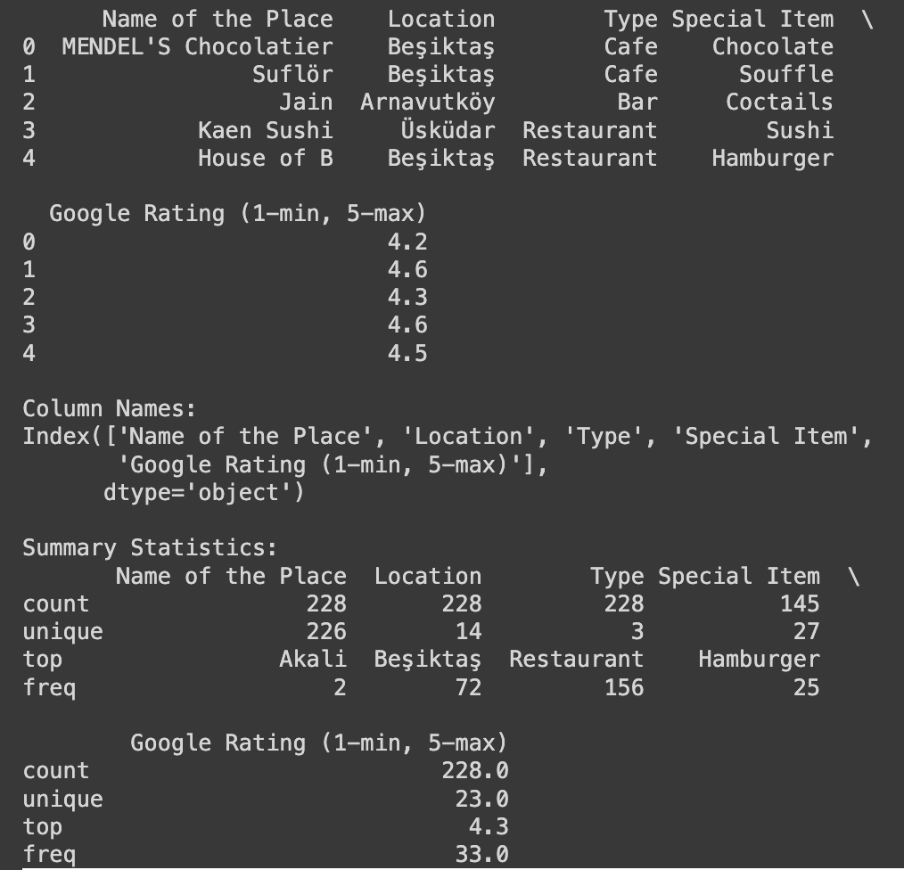
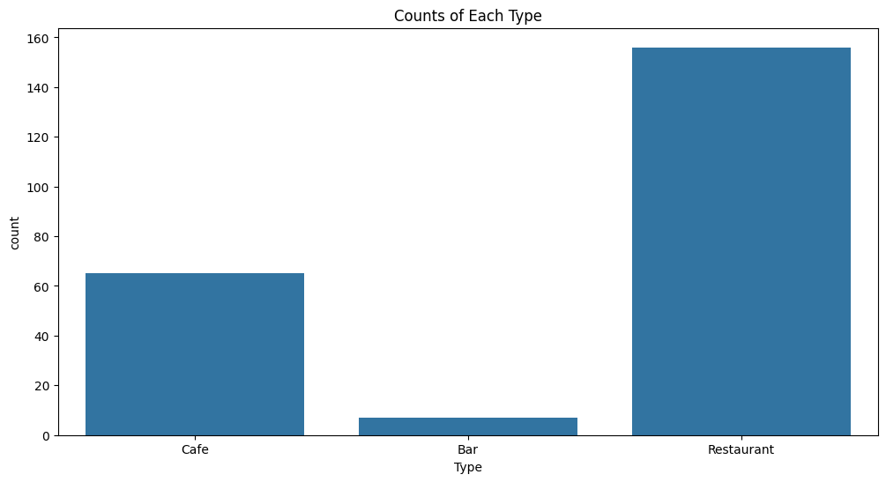
Data Interpretation
Examined 3 types of places:
Cafe
Bar
Restaurant

Slide 6
Data Interpretation
Visualisations:
Average Ratings by Location
Location-wise Ratings Heatmap
Average Ratings by Type
Scatterplot of Ratings vs. Special Item
EDA methods were used.

Slide 7
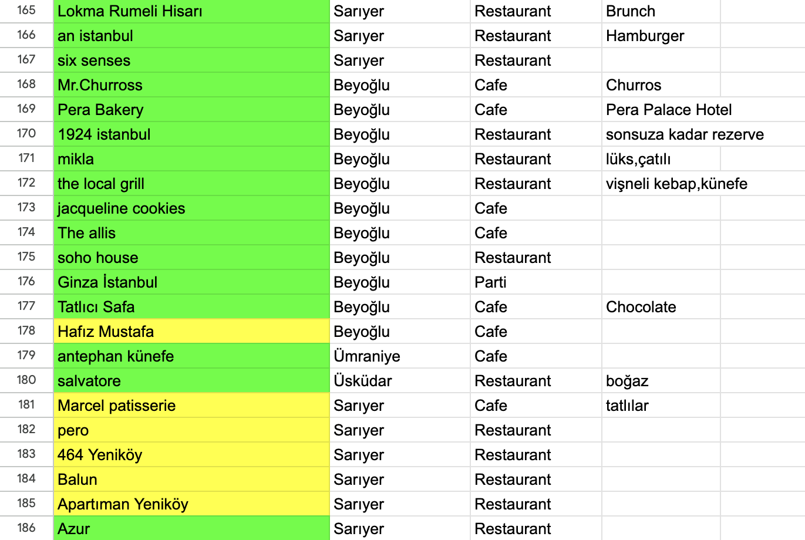
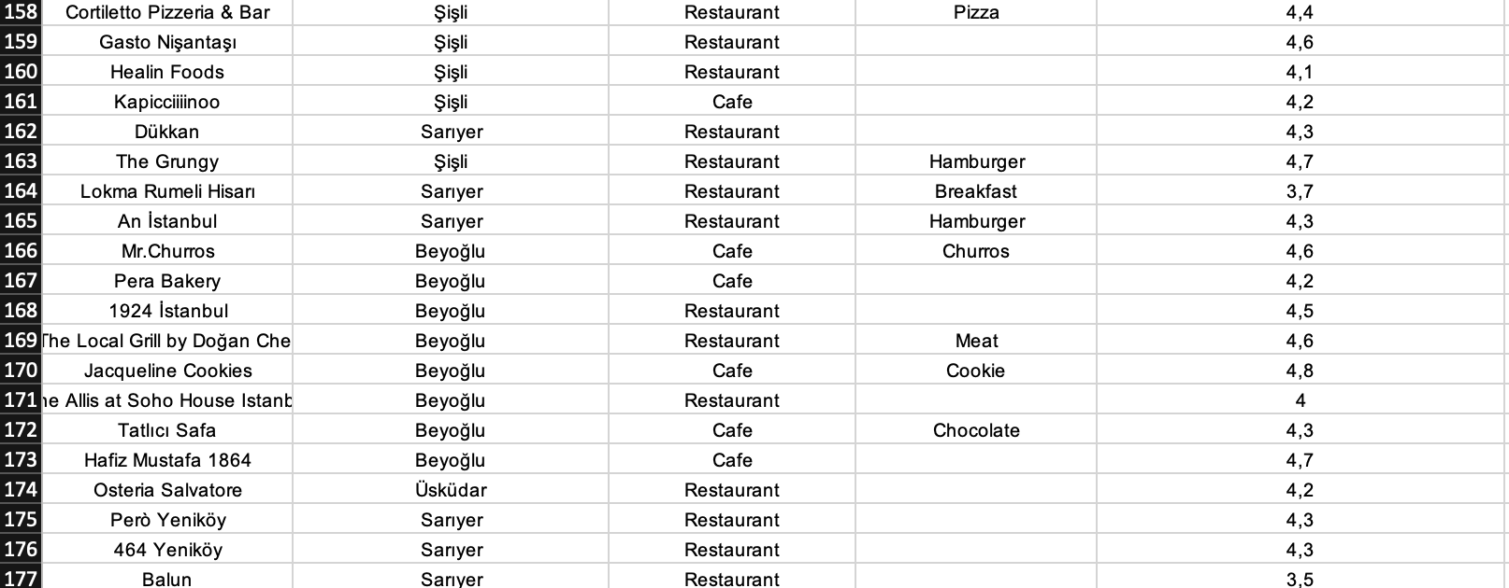
Data Interpretation
Old Version
New Version
EDA methods were used.

Slide 8
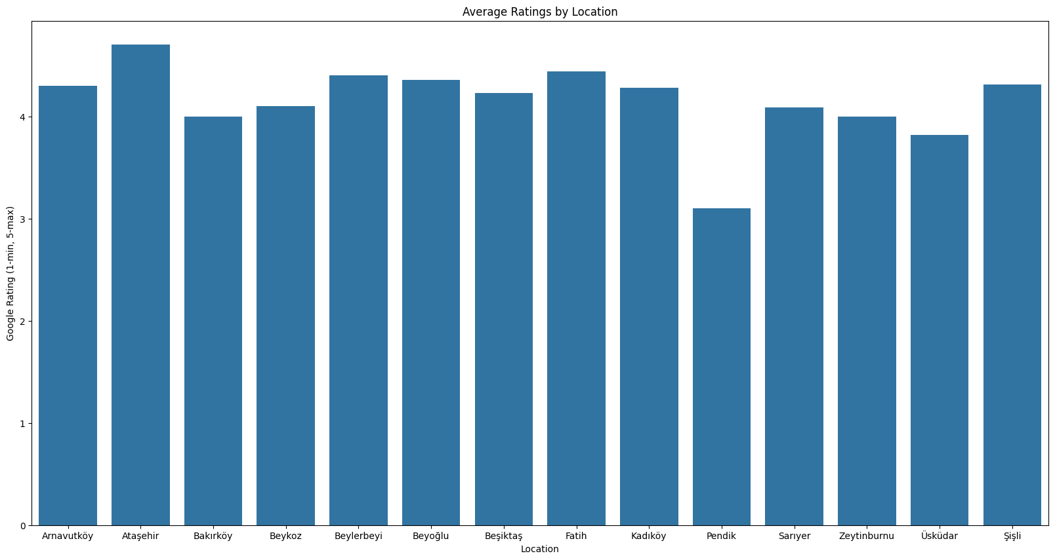
Data Interpretation
Average Ratings by Location

Slide 9
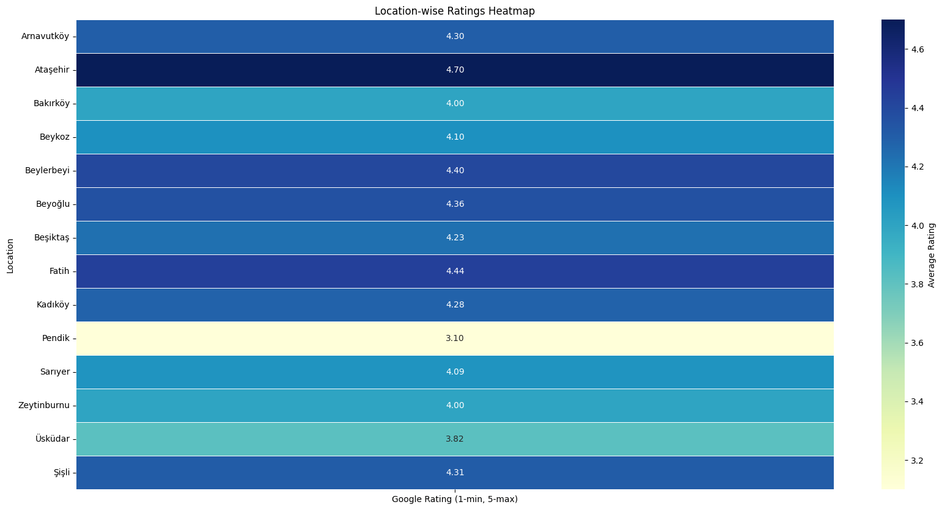
Data Interpretation
Location-wise Ratings Heatmap

Slide 10
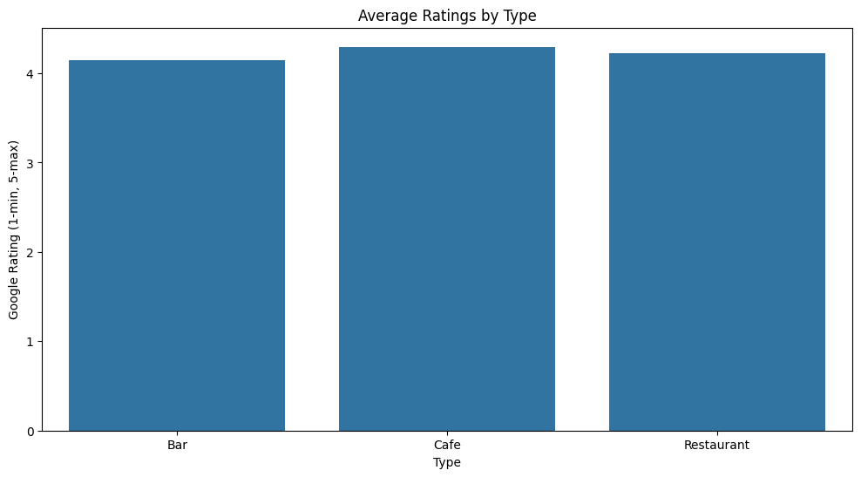
Data Interpretation
Average Ratings by Type

Slide 11
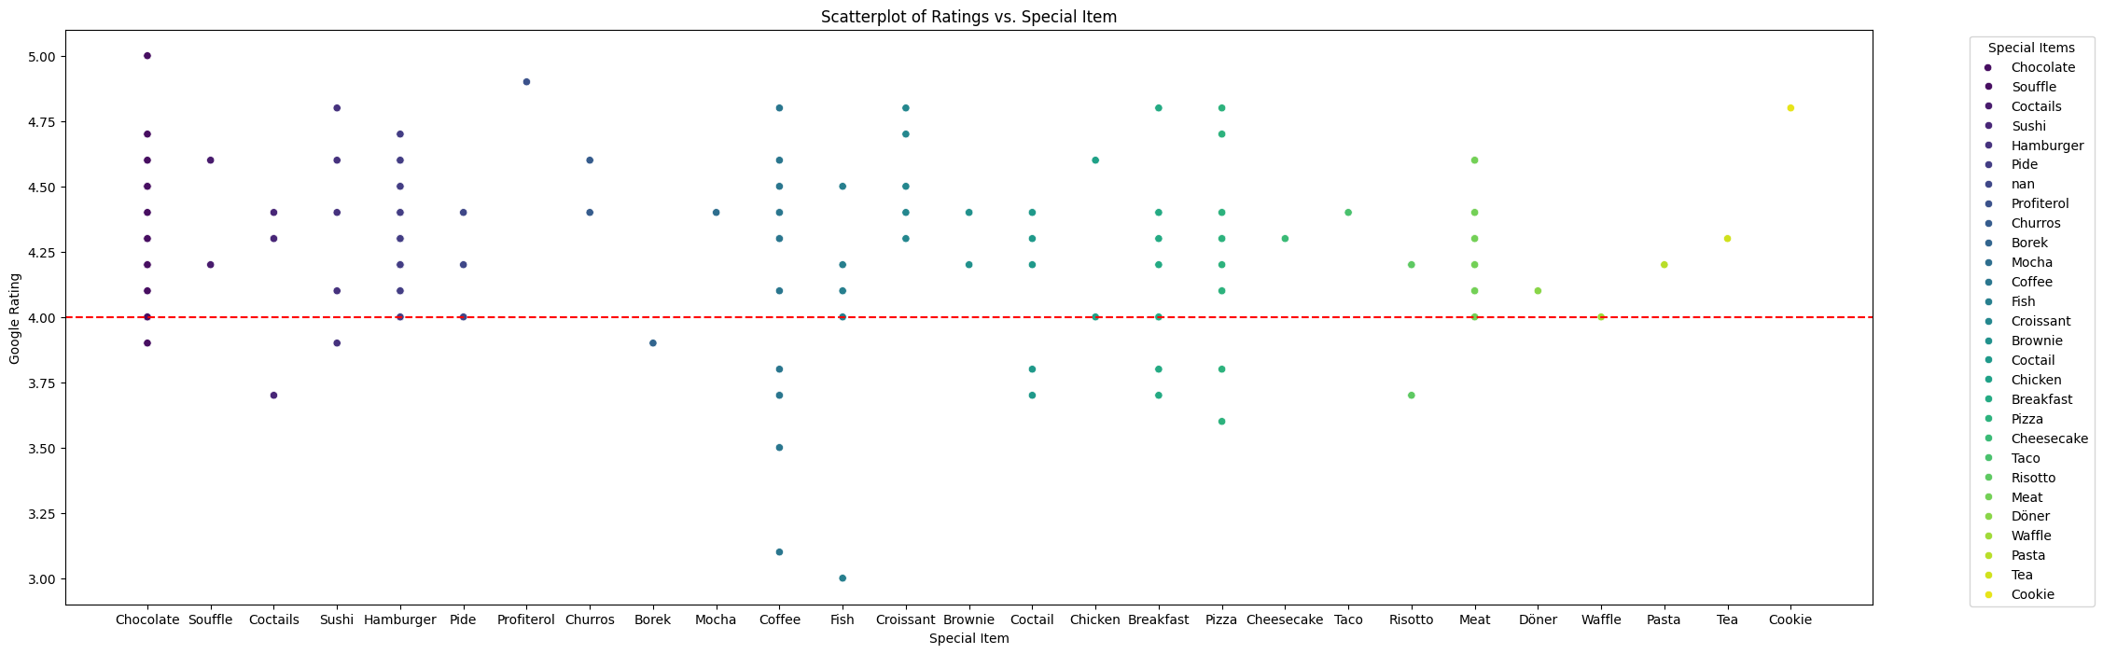
Data Interpretation
Scatterplot of Ratings vs. Special Item

Slide 12
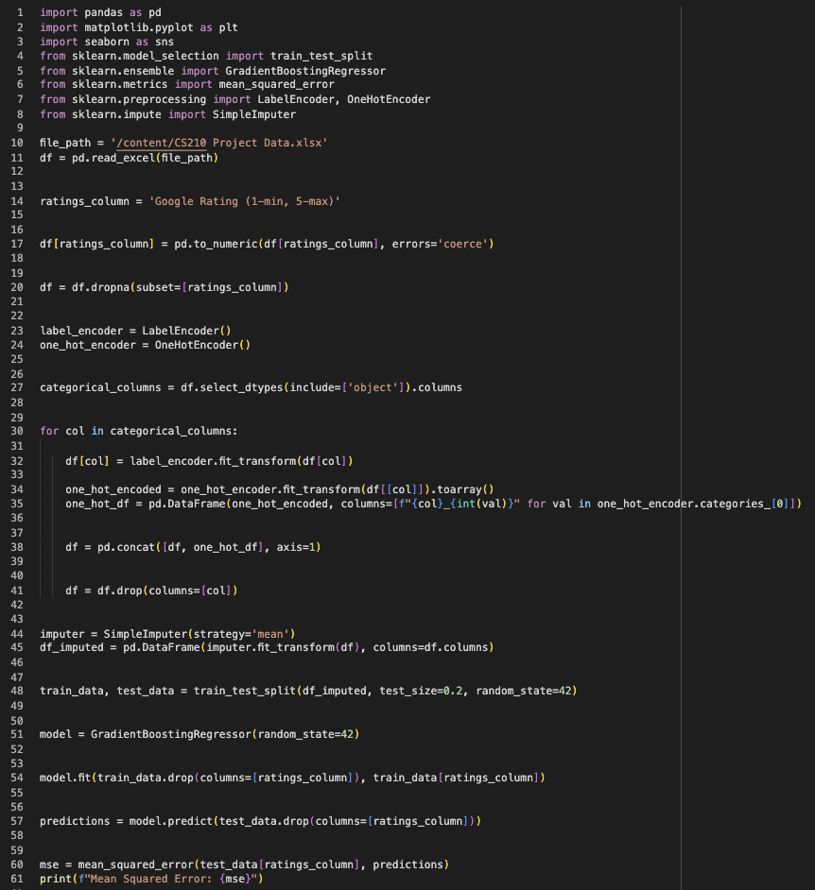
Machine Learning
Gradient Boosting Regressor
Prediction-actual difference measure
Positive Number
Lower MSE, better fit
1)
MSE
2)
3)

Slide 13
Results & Discussion
Hypothesis:
Overall Looking To The Project
The project aims to analyze Google ratings for Istanbul's bars, restaurants, and cafes. It will provide insights into correlations between ratings, locations, and business types, culminating in a machine learning model to predict ratings based on various features.

